Slide 1
Capstone Project The Battle of Neighborhoods
Ryan Cooley
02.26.2020

Slide 2
Background & Problem Description
New York City is one of the most diverse and populated cities in the world. It is a melting pot of different cultures and cuisines from around the world. It is also considering a foodie heaven because there are so many options. That means that there are a lot of options to choose from and that selecting the best place can be tough. It should be important to know which places are the best depending upon the neighborhood you are in. This project will help to understand the diversity of a neighborhood by leveraging venue data from Four square's ‘Place API’ and ‘k-means’ clustering machine learning algorithm. The audience would be anyone that is interested to use this analysis to understand the distribution of different cultures and cuisines in New York City.

Slide 3
Data Preparation
These are the Data Sources Used for this Analysis:
New York Data Set: https://geo.nyu.edu/catalog/nyu_2451_34572
The data set will be our base neighborhood data set to cross reference against the Foursquare API venue data
Foursquare API: to get the most common venues of given Borough of New York City and to get the venues' record of given venues of New York City.
Geophy Library in Python: this will help us get the Lat and Long of the NYC data set

Slide 4
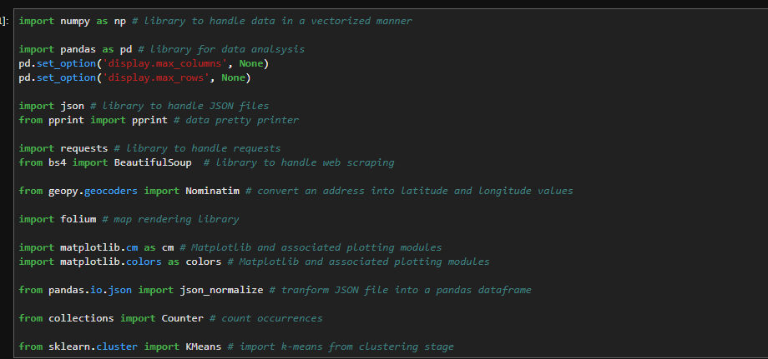
Methodology: Loading Dependencies
We will first download all the dependencies:

Slide 5
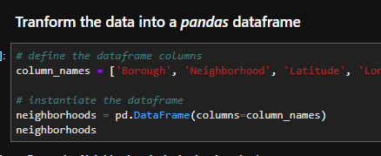
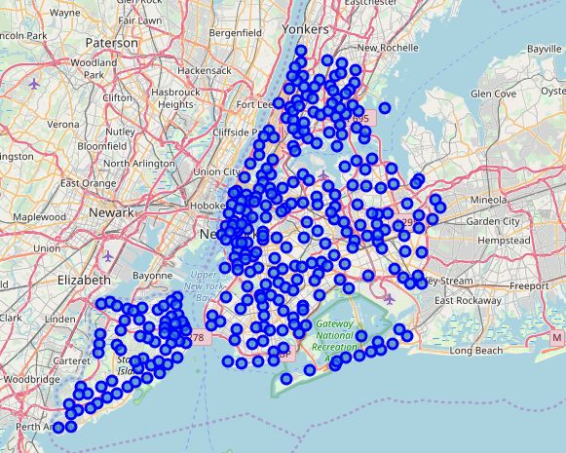
Methodology: Transforming and Exploring the Data Set
1. We upload the JSON file and transform it in a Pandas Data Frame
2. When then use the Geopy library to get the Lat and Long and create map:

Slide 6
Methodology: Appending Foursquare data to the NYC Data set
We will take the following steps to append the data set:
Create the API request URL with our Foursquare developer credentials
Make the GET request
Return only relevant information for each nearby venue within our NYC data set
Append all nearby venues to a list

Slide 7
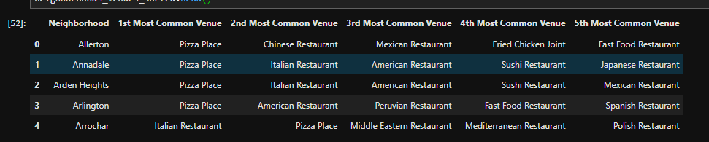
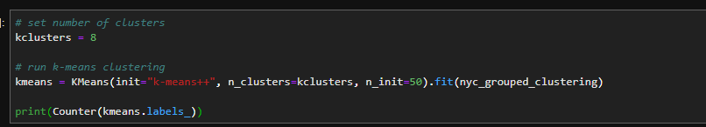
Methodology: K-Means Clustering
We will chose the K-Means Clustering Algorithm to help build segments for the neighborhoods based on types of cuisines in that particular neighborhood:
We will first explore and group the data set:
We will then use two different methods to evaluate how much clusters we need (Elbow and Silhouette Methods for Optimal k (see next slide for detail):
Once we pick a method for the optimal number K, we will run the model:

Slide 8
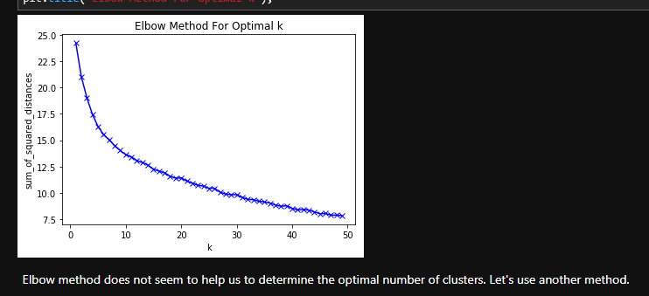
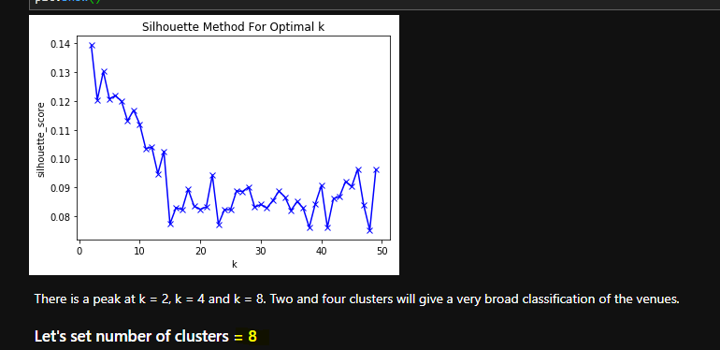
Methodology: Custer Evaluation
Elbow Method - calculate the sum of squared distances of samples to their closest cluster center for different values of k. The value of k after which there is no significant decrease in sum of squared distances is chosen.
Silhouette Method - value measures how similar a point is to its own cluster (cohesion) compared to other clusters (separation)
We will set the cluster number to 8 based on Silhouette Method base on the data set

Slide 9
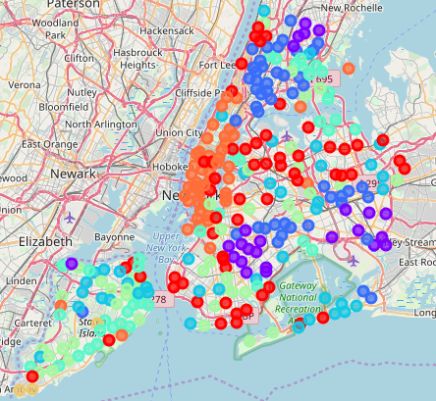
Results: High Level Clusters (Segments)
The model produced 8 segments grouping the neighborhoods by borough and by Cuisines type. The map to the right is a high level view of the clusters created
0 - Pizza/Fast Food – Queens & Brooklyn
1 – Caribbean Cuisines – Brooklyn & Queens
2 – Italian/Pizza – Staten Island
3 – Italian/Pizza/American – Manhattan, Brooklyn, & Queens
4 – Pizza/Italian – Staten Island & The Bronx
5 – Italian/Vietnamese - Staten Island
6 – Mix of Cuisines – Staten Island
7 – American – Manhattan *& Brooklyn
The Next Slides will break down the clusters or segments we created

Slide 10
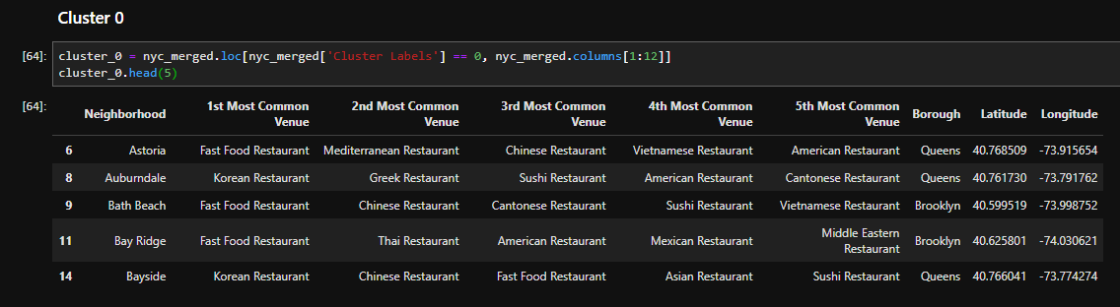
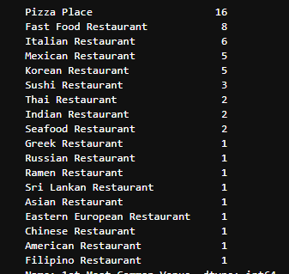
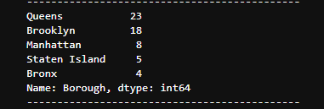
Results: Cluster 0
Segment 0 are neighborhoods that had a major of restaurants that are Pizza Place and Fast Food
Most of the neighborhoods reside in Brooklyn and Queens

Slide 11
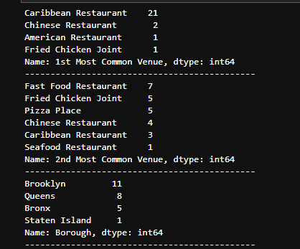
Results: Cluster 1
Segment 1 is a mostly neighborhoods that are Caribbean.
Most of these neighborhoods reside in Brooklyn and Queen

Slide 12
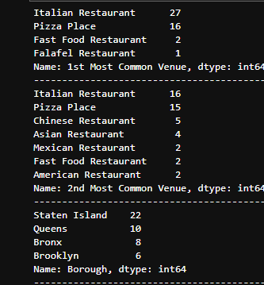
Results: Cluster 2
Segment 2 are mostly a mix of Italian/Pizza
Most reside in Staten Island

Slide 13
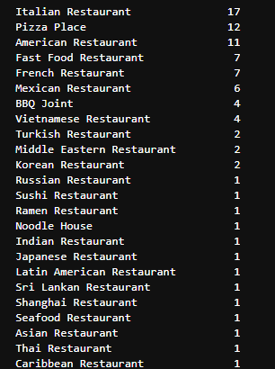
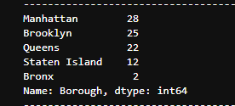
Results: Cluster 3
Segment 3 are heavy Italian, Pizza, and American
This is our largest segment with a majority of neighborhoods in Manhattan, Brooklyn, and Queens.

Slide 14
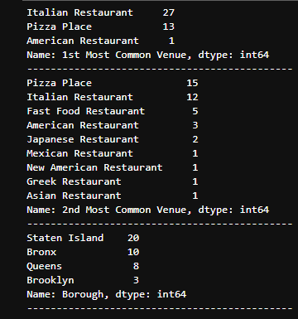
Results: Cluster 4
Segment 4 are neighborhoods that are heavy Italian Restaurants and Pizza Places
Most are located in Staten Island and the Bronx

Slide 15
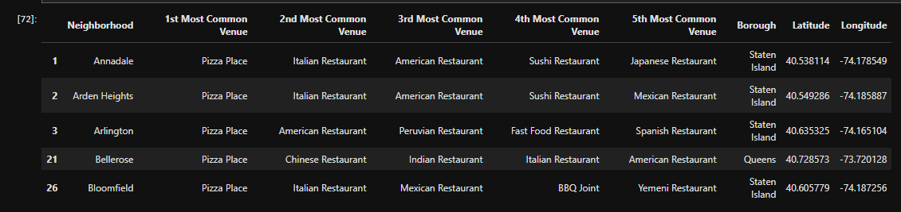
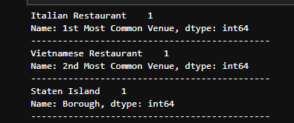
Results: Cluster 5
Segment 5 are neighborhoods that have a variety or “diverse” amount of cuisines mostly in Staten Island

Slide 16
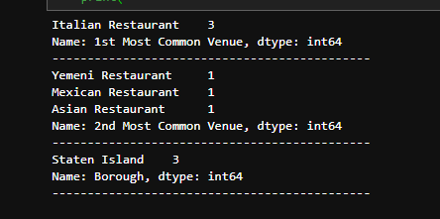
Results: Cluster 6
Segment 6 are neighborhoods on Staten Island that are primary Italian Restaurants

Slide 17
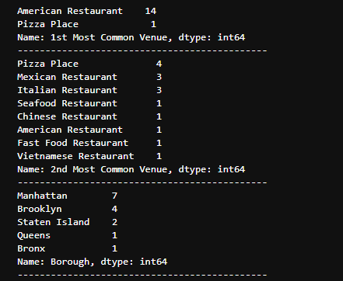
Results: Cluster 7
Segment 7 are neighborhoods that a majority of restaurants that are American
Manhattan has the most at 7

Slide 18
Results: High Level
We segments the neighborhoods into 8 different segments depending on what type of cuisine was most common:
0 - Caribbean
1 - Chinese
2 - Italian
3 – Italian American
4 – Pizza
5 – Mix of Cuisines
6 – Fast Food
7 - American

Slide 19
Discussion
Three analysis were down to understand the clusters:
Count of Borough
Count of 1st Mot Common Venue
Count of 2nd Most Common Venue
As reference on slide 9, Pizza was the most common venue amongst all of the clusters. We did discover that there seems to be a variety of other venues associated with the clusters with pizza. Staten Island seemed to have the most diverse clusters.

Slide 20
Conclusion.
By applying the cluster algorithm, K-means, to a multi-dimensional dataset, a very detail result set can be created to help us understand and visualization the neighborhoods and culture in NYC based on the type of cuisines venues there are. Pizza and Italian were very most dominate in NYC but there were also a lot of Asian and Caribbean venues as well. That speaks to the diversity of the city.
The results from the project could be improved by maybe incorporating an API from Yelp! to get customer feedback and ratings of venues into this dataset. This would help the stakeholders get an idea of how good a place is based on the average customer review and rating.

